Slide 1

Real-time prediction of 30-day hospital readmission risk using ehr data
Kellen Griswold, BSMIS, RRT, RRT-ACCS
Colorado State University Global
MIS581: Capstone – Business Intelligence & Data Analytics
May 10, 2026
Notes:
“Hello everyone.”
Introduce yourself. CQSS from Univ. of Colorado Health system.
“I want to thank you for attending this presentation of my research project. It is titled…”
“This project focuses on the use of electronic health record data to predict which hospitalized patients are at elevated risk for readmission within 30 days of discharge.
I also compare the performance of logistic regression with machine learning approaches to evaluate whether increased model complexity results in meaningful improvements in predictive performance.
Throughout this presentation, I’ll discuss the research problem, methodology, key findings, and practical recommendations for healthcare organizations.”

Slide 2

Research Problem & background
30-day readmissions are costly
A central focus of quality improvement initiatives (Sharda et al., 2025)
Early identification allows targeted interventions
EHR data enable a comprehensive risk assessment (Tang et al., 2024)
Notes:
“30-day hospital readmissions continue to represent a major challenge for healthcare organizations in the United States.
These readmissions are associated with increased healthcare costs, poorer patient outcomes, and financial penalties under value-based reimbursement programs.
They are costly, and because of this, reducing avoidable readmissions has become a major focus of quality improvement initiatives across healthcare systems.
One of the key opportunities in this area is the ability to identify high-risk patients before discharge so that targeted interventions can be implemented when they are most effective, while the patient is still hospitalized.
Some examples of these interventions may include enhanced discharge education, medication reconciliation, care coordination, or post-discharge follow-up planning.
The widespread adoption of EHRs has made this increasingly possible because EHR systems contain detailed patient-level information including demographics, diagnoses, utilization history, and clinical severity indicators.
This study evaluates whether those real-time EHR variables can be used to meaningfully predict readmission risk prior to discharge.”

Slide 3
Research Questions & Hypotheses
RQ1: Can EHR data be used to predict 30-day readmissions?
H_{0,1}: EHR data cannot accurately predict 30-day readmissions
Can be rejected with AUROC value ≥ 0.7 (Supported by Pandey et al., 2025 and Sharda et al., 2025)
RQ2: Do machine learning (ML) models outperform Logistic Regression (LR)?
H_{0,2}: There is no statistically significant difference in model performances
Can be rejected with p-value < 0.05 using DeLong’s Test
Notes:
“This study was guided by two primary research questions.
The first research question asked whether patient-level EHR data available during hospitalization could be used to accurately predict 30-day hospital readmissions.
To evaluate this, I developed a Logistic Regression model and assessed whether it achieved meaningful predictive performance.
Using prior literature as a reference point, meaningful performance was defined as an AUROC value greater than or equal to 0.70.
The second research question examined whether machine learning models outperform Logistic Regression.
To evaluate this question, I compared a Logistic Regression model to Random Forest and Gradient Boosting models.
DeLong’s Test for correlated ROC curves was then used to assess for statistically significant differences in improvement, defined as a p-value of less than 0.05.
Together, these research questions allowed me to evaluate both predictive capability and the practical tradeoff between model complexity and interpretability.”

Slide 4
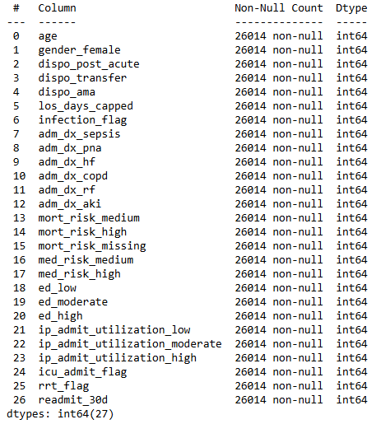
Research Design & Dataset
Retrospective study
EHR-based dataset
26,014 inpatient admissions
26 predictor variables
70/30 train-test split
Significant class imbalance
Notes:
“This study used a retrospective quantitative research design based on inpatient EHR data from calendar year 2025.
The final analytical dataset included 26,014 inpatient admissions and 26 predictor variables.
These variables included demographic information, admission diagnoses, healthcare utilization indicators, discharge disposition, and patient risk scores.
Importantly, each of these variables were intentionally selected based on their availability during hospitalization, meaning that risk predictions could theoretically be generated in real time before discharge.
Prior to modeling, the full dataset was divided into 70% training and 30% testing datasets to evaluate model performance on previously unseen observations and to reduce overfitting.
One major challenge in the dataset was class imbalance. At a ratio of nearly 10:1, there was a substantial majority of non-readmitted patients over readmitted patients, as you would likely expect.
To address this, class weighting techniques were applied during model development to help the models to better identify high-risk patients.”

Slide 5
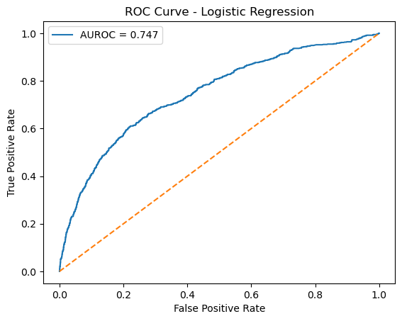
Logistic Regression Results
AUROC: 0.747
Sensitivity: 0.56
Specificity: 0.81
Precision: 0.23
H_{0,1} rejected (AUROC ≥ 0.70)
Notes:
“The Logistic Regression model achieved an AUROC value of 0.747.
This indicates a meaningful discriminative ability between readmitted and non-readmitted patients.
At the default classification threshold of 0.5, the model achieved:
a sensitivity of 0.56,
a specificity of 0.81,
and a precision value of 0.23.
In other words, this means the model correctly identified 56% of readmitted patients while correctly identifying 81% of non-readmitted patients.
Although the precision value appears relatively low, this is expected in datasets that have substantial class imbalance.
Most importantly, the AUROC value exceeded the predefined threshold of 0.70, allowing for the rejection of the first null hypothesis.
This supports the conclusion that EHR data available during hospitalization can, in fact, be used to meaningfully predict 30-day readmission risk.”

Slide 6
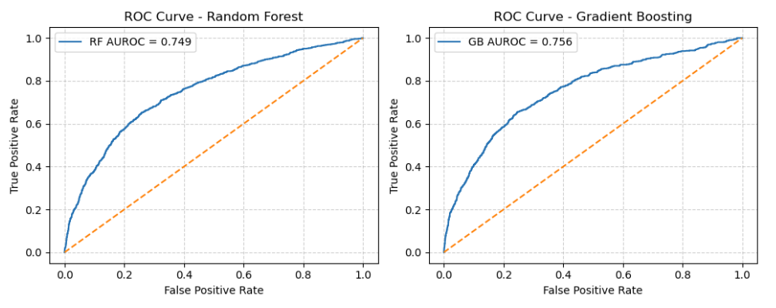
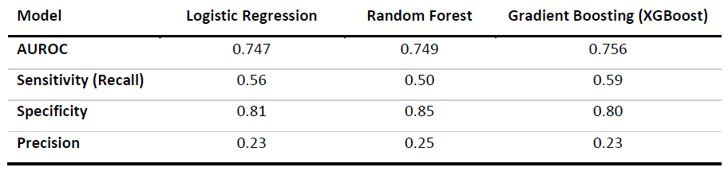
Machine Learning Comparison
DeLong’s Test Results
LR vs RF p-value: 0.694
LR vs GB p-value: 0.073
H_{0,2} cannot be rejected
Notes:
“To evaluate the second research question, two machine learning models were developed: a Random Forest model and a Gradient Boosting model.
The Random Forest model achieved an AUROC of 0.749, while the Gradient Boosting model achieved the highest AUROC at 0.756.
Although the machine learning models demonstrated slightly improved performance when compared to Logistic Regression, these differences were relatively small.
To formally assess if there was statistical significance in these differences, DeLong’s Test was performed, in alignment with the second null hypothesis.
The comparison between Logistic Regression and Random Forest produced a p-value of 0.694, while the comparison between Logistic Regression and Gradient Boosting produced a p-value of 0.073.
Because neither comparison achieved a p-value below the conventional threshold of 0.05, the second null hypothesis could not be rejected.
These findings suggest that increased model complexity did not result in a statistically meaningful improvement in predictive performance for this study.”

Slide 7
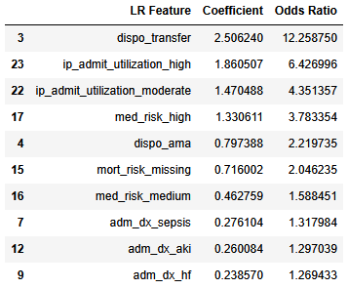
Key Predictors of Readmission
Discharge disposition
Prior inpatient utilization
Patient risk scores
Admission diagnoses
Consistent with existing evidence (Li et al., 2024; Selmer et al., 2025)
Notes:
“There were several variables that consistently emerged as strong predictors of readmission risk across each of the models.
Discharge disposition demonstrated one of the strongest relationships with readmission, particularly among patients discharged to another facility such as a skilled nursing or rehab facility.
Prior inpatient utilization was another strong predictor, as patients with more extensive hospitalization histories appear to be at substantially higher risk for future readmissions.
Patient risk scores also demonstrated meaningful associations with readmission outcomes.
Overall, these findings are largely consistent with existing literature, which emphasizes the importance of patient complexity, healthcare utilization patterns, and care coordination challenges in predicting readmission risk.”

Slide 8

Recommendations
Implement an LR-based prediction model
Integrate into workflows as clinical decision support
Use adjustable classification thresholds
Continuously monitor/recalibrate the model
Notes:
“Based on the findings of this study, several recommendations can be made for healthcare organizations.
First, organizations should consider implementing a Logistic Regression-based prediction model within their EHR systems.
Its performance was just below the more complex machine learning approaches while offering greater interpretability and transparency.
Second, predictive models should be integrated directly into discharge planning and care coordination workflows as clinical decision support tools.
If well founded, the identified high-risk patients could then receive targeted interventions, aimed at preventing further readmissions, prior to discharge.
Third, healthcare organizations should consider using adjustable classification thresholds depending on their operational priorities and resource availability.
Lower thresholds may improve sensitivity and identify more high-risk patients, though it usually comes at the cost of an increase in false positives.
Finally, predictive models should be continuously monitored and recalibrated over time to maintain performance as patient populations and healthcare workflows evolve.”

Slide 9
Conclusion
EHR data can meaningfully predict readmissions
LR model performed nearly as well as ML models
Interpretability matters in clinical applications
Predictive analytics can improve discharge planning
Notes:
“In conclusion, this study demonstrated that patient-level EHR data available during hospitalization can be used to meaningfully predict 30-day hospital readmission risk.
Although machine learning models achieved slightly higher predictive performance, these improvements were modest and not statistically significant.
As a result, Logistic Regression may provide the best balance between predictive capability, interpretability, and practical implementation within clinical workflows.
Overall, these findings support the growing role of predictive analytics in healthcare and demonstrate how data-driven approaches can improve discharge planning, care coordination, and patient outcomes while helping organizations reduce avoidable readmissions.”

Slide 10
References
Li, X., Liu, S., Yu, D., Zhang, Y., & Liu, X. (2024). Predicting 30-day hospital readmission in Medicare patients: Insights from an LSTM deep learning model. 2024 3rd International Conference on Cloud Computing, Big Data Application and Software Engineering (CBASE), 61–65. https://doi.org/10.1109/cbase64041.2024.10824316
Pandey, S. R., Tile, J. D., & Oghaz, M. M. (2025). Predicting 30-day hospital readmissions using ClinicalT5 with structured and unstructured electronic health records. PLOS One, 20(9). https://doi.org/10.1371/journal.pone.0328848
Selmer, N., Berthelsen, C., Van Grootven, B., Meyer, G., & Loft, M. I. (2025). Identifying risk prediction models and predictors for hospital readmission in patients with medical conditions: A systematic review and meta-analysis. International Journal of Nursing Studies, 171, 105188. https://doi.org/10.1016/j.ijnurstu.2025.105188
Sharda, M., Sharma, S., Raikar, S., Verhagen, N., Wagle, J., Mathur, R., Gowda, S., Kommu, S., Prasad, R., Bhandari, S., & Jha, P. (2025). The role of machine learning in predicting hospital readmissions among general internal medicine patients: A systematic review. Cureus. https://doi.org/10.7759/cureus.84761
Tang, A. S., Woldemariam, S. R., Miramontes, S., Norgeot, B., Oskotsky, T. T., & Sirota, M. (2024). Harnessing EHR data for health research. Nature Medicine, 30(7), 1847–1855. https://doi.org/10.1038/s41591-024-03074-8
Notes:
“These are several of the references that were used throughout this project, all very recent and relevant to the subject.
That’s the end of my presentation. I hope you find it to be informative and engaging.
Thank you so much for your time and attention and I hope you have a great week… I know I am!”

